Slide 1

Object Detection for Autonomous Vehicles By:- Pavni Shri Gupta

Slide 2
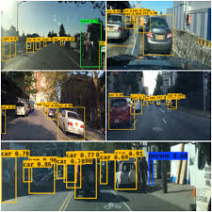
Introduction
Autonomous vehicles rely on computer vision and deep learning to detect objects in real time.
Object detection helps in identifying vehicles, pedestrians, traffic signs, and other obstacles on the road.
This project implements YOLOv5, a state-of-the-art deep learning model, to detect objects efficiently.
The goal is to enhance road safety and autonomous navigation by providing accurate object detection.

Slide 3
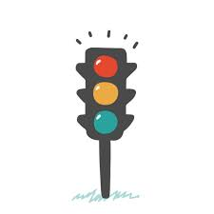
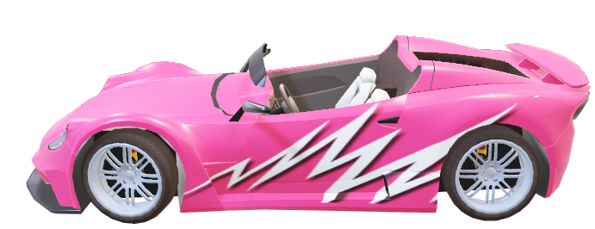
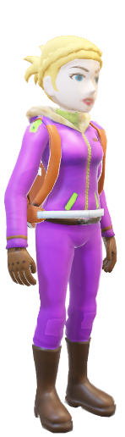
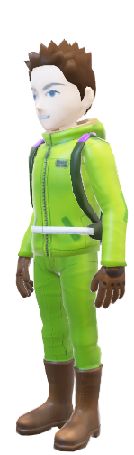
Objective
Develop a real-time object detection system for autonomous vehicles.
Detect vehicles, pedestrians, and traffic signs to improve road safety.
Use YOLOv5 for deep learning-based detection with high accuracy.
Provide an interactive GUI for users to load files and visualize results.

Slide 4
Background (Object Detection & YOLOv5)
What is Object Detection?
A computer vision technique to identify objects in images/videos.
Used in self-driving cars, surveillance, and AI-powered applications.
Why YOLOv5?
You Only Look Once” (YOLO) is a deep learning model designed for real-time object detection.
Unlike older models, YOLO processes an image in a single pass, making it faster and more accurate.
Used in autonomous driving, security surveillance, and industrial applications.

Slide 5
Hardware & Software Requirements
Hardware Requirements:
Processor: Intel Core i5/i7 (or equivalent AMD).
RAM: Minimum 8GB (16GB recommended for deep learning tasks).
GPU: NVIDIA GPU (Recommended for faster inference).
Storage: Minimum 10GB free space.
Software Requirements:
Operating System: Windows 10/11, Linux, macOS.
Programming Language: Python 3.x.
Libraries & Dependencies: Torch & Torch vision (for deep learning inference).
OpenCV (for image & video processing).
Tkinter (GUI for user interaction).
YOLOv5 (pre-trained object detection model).
Development Environment: VS Code, PyCharm, or Jupyter Notebook.

Slide 6
Future Scope
Live Video Streaming: Implementing real-time object detection from a live camera feed.
Multi-Object Tracking: Following detected objects over time to predict movement.
Integration with Simulations: Using platforms like CARLA to test self-driving scenarios.
Edge Computing Optimization: Running detection on embedded systems (e.g., Raspberry Pi).
Improved Accuracy: Training a custom YOLO model on a dataset specific to road environments.

Slide 7
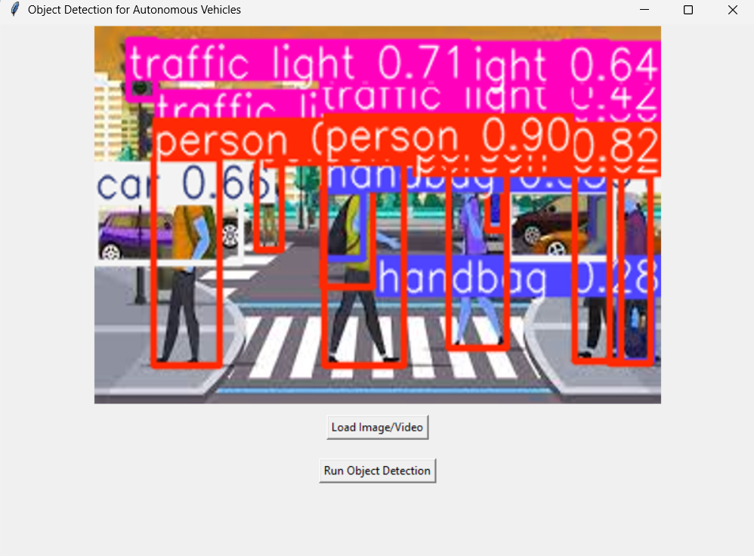
Conclusion
This project successfully implements real-time object detection using YOLOv5 & Python.
The system efficiently detects and labels objects like vehicles, pedestrians, and traffic signs.
The project can be enhanced with real-time performance optimizations and integration with autonomous driving systems.
Future improvements will focus on edge computing, real-time tracking, and enhanced model training.

Slide 8
References & Bibliography
Redmon, J., & Farhadi, A. (2018). YOLOv3: An Incremental Improvement.
Ultralytics YOLOv5 Documentation: https://github.com/ultralytics/yolov5
OpenCV Library: https://opencv.org/
Python Official Documentation: https://docs.python.org/3/
Research Papers on AI in Autonomous Vehicles

Slide 9
Thank You

